Slide 1
13 Colonies Preview – New England, Middle, and Southern

Slide 2
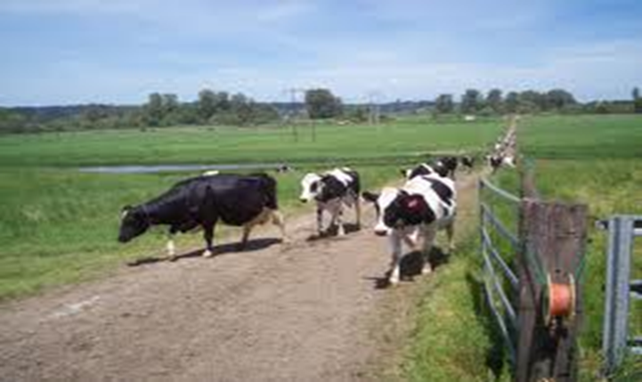
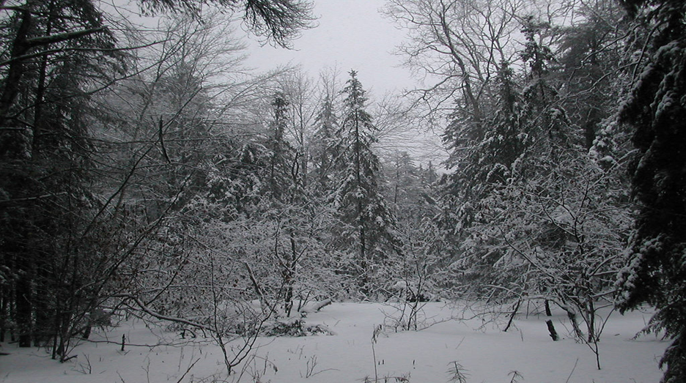

Slide 3
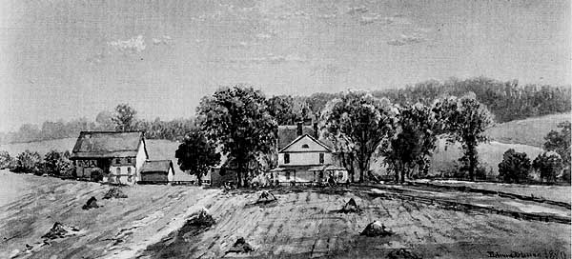

Slide 4
