Slide 1
Bill of Rights Matrix
Mr. Gonzalez 2016 - 2017

Slide 2
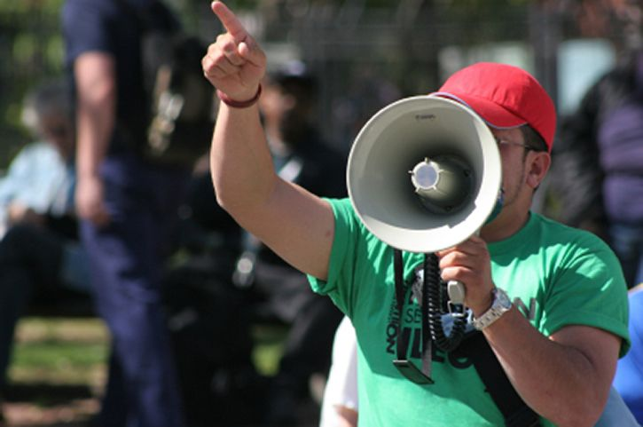
Guess the Amendment…

Slide 3
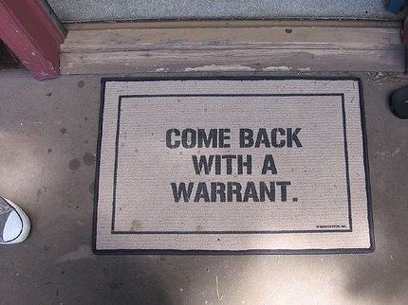
Guess the Amendment…

Slide 4
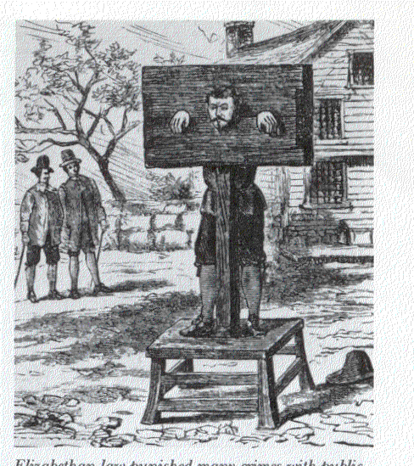
Guess the Amendment…

Slide 5
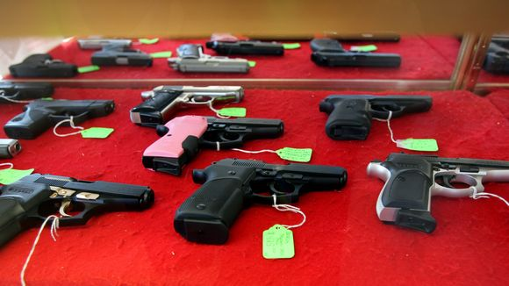
Guess the Amendment…

Slide 6
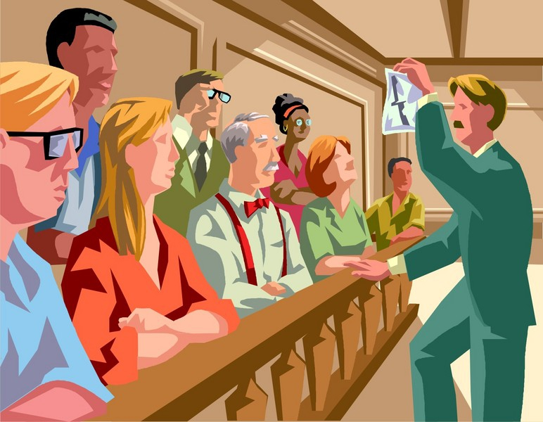
Guess the Amendment…

Slide 7

Guess the Amendment…

Slide 8

Guess the Amendment…

Slide 9

Guess the Amendment…

Slide 10
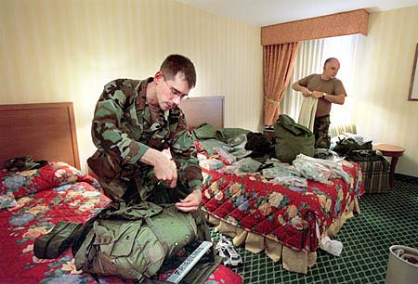
Guess the Amendment…

Slide 11

Guess the Amendment…
…even if they aren’t listed.

