Slide 1
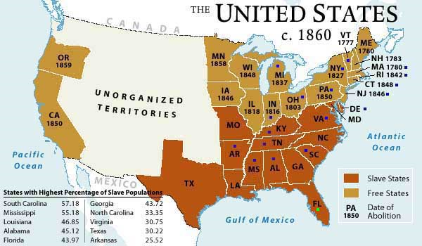
The Advent of the Civil War

Slide 2
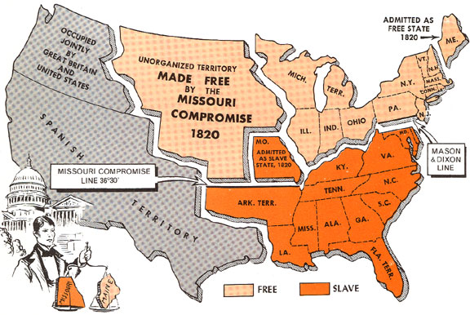
The Missouri Compromise - 1820
1. Was this more of a victory for pro-slavery people or anti-slavery people?

Slide 3
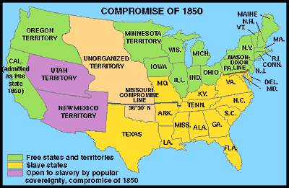
The Compromise of 1850
2. After the Mexican-American War and the inclusion of new territory into the union, the U.S. government had to make rules regarding slavery in these new lands. Was this more of a victory for pro-slavery people or anti-slavery people?

Slide 4
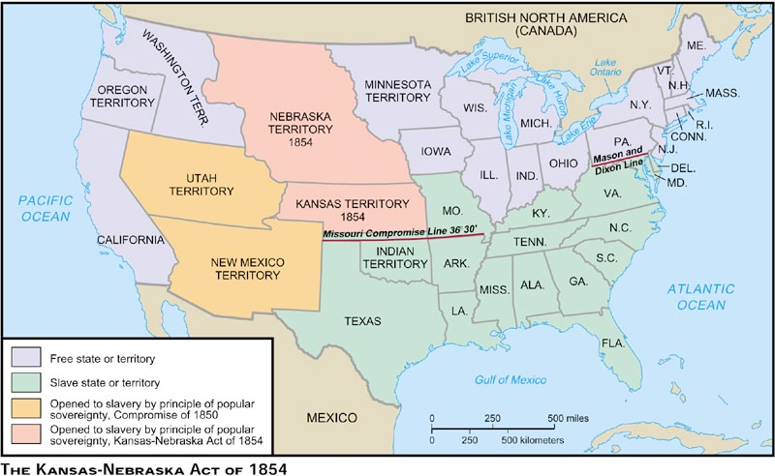
The Kansas-Nebraska Act of 1854
3. Was this more of a victory for pro-slavery people or anti-slavery people?

Slide 5
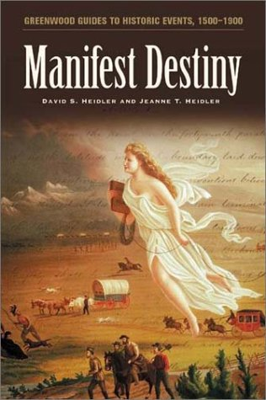
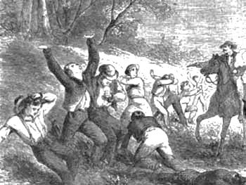
In many ways, the Civil War was brought on by conflicts over slavery expanding into the American West.
For example, Americans delayed annexing Texas, in part, over opposition to slavery. Also, as people settled in Kansas Territory, some anti-slavery and pro-slavery groups began to fight. They called it “Bleeding Kansas.” A “Beecher Bible” was a name for a gun which came from a Northern abolitionist preacher named Beecher who advocated using violence to stop slavery.
4. Why was Kansas called “Bleeding Kansas”?

Slide 6
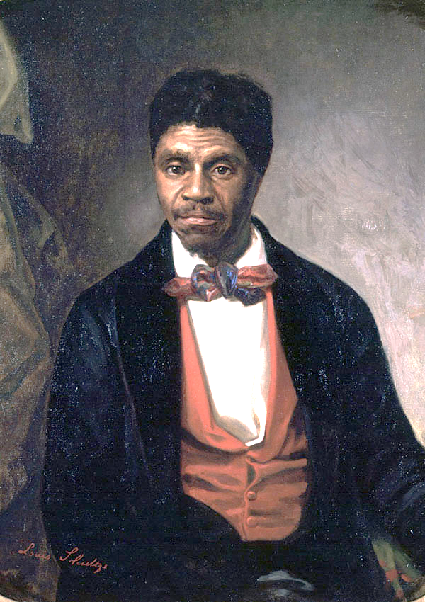
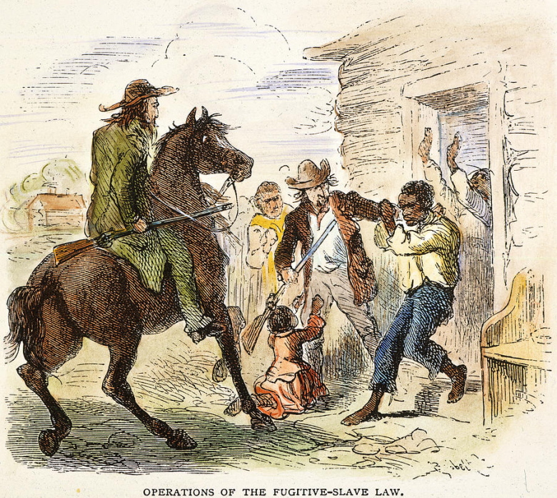
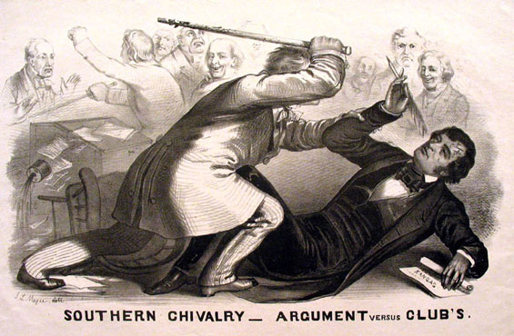
Many people in the rest of the country began to take sides on the question of whether slavery should expand into the West and even into other parts of the North.
5. How were Northerners forced into supporting slavery?
Many Northerners were upset by an 1850 law requiring them to help catch runaway slaves, or they could get in trouble with the police.
Also, Dred Scott was a runaway slave who sued for his freedom in Wisconsin (a free state). The Supreme Court ruled he was still a slave even in a free state. This decision threatened to expand slavery everywhere.
Two Senators fighting in Congress over slavery disputes.
6. Why did Northerners dislike the Dred Scott ruling?

Slide 7
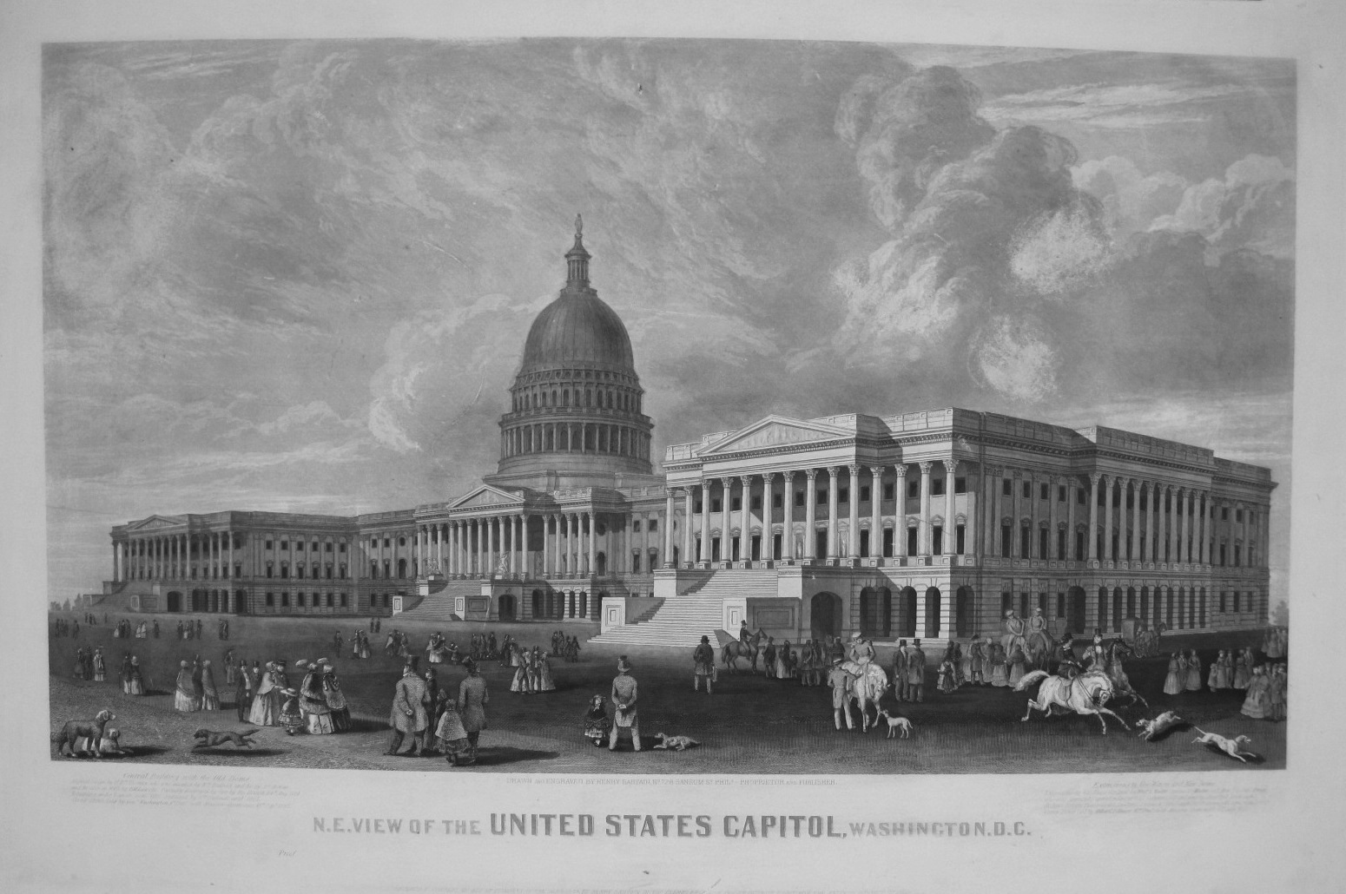
Conflicts Over Political Power
Number of Free and Slave States in 1860
Non-slave States (North)= 18
Slave States (South)= 15
7. Who had more power in the U.S. Senate?
Population of Free and Slave States in 1860
Non-slave States (North)= 30 million
Slave States (South)= 12 million
8. Who had more power in the U.S. House of Representatives?

Slide 8
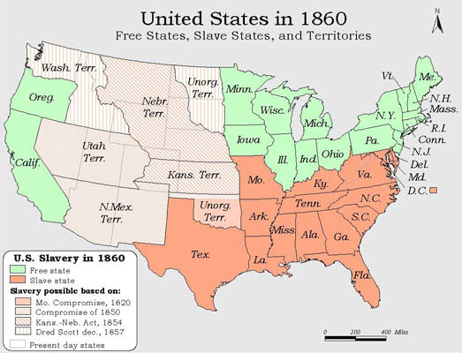
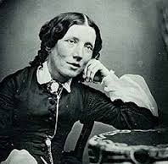
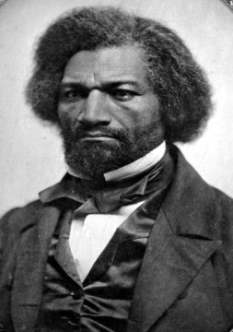
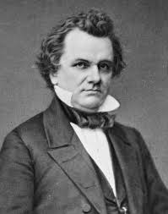
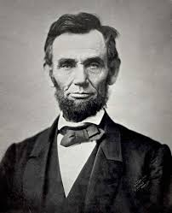
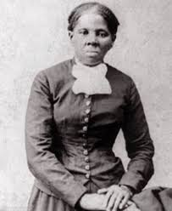
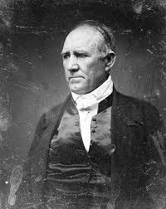
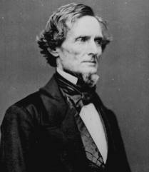
Political Parties and Interest Groups
All groups have a particular point of view on slavery

Slide 9
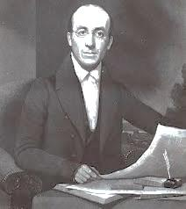
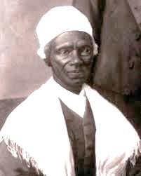
Northern Abolitionists
William Lloyd Garrison ran an abolitionist newspaper called the Liberator and was part of the American Anti-Slavery Society
Frederick Douglass was a speaker, writer, and activist against slavery.
9. What kinds of activities did abolitionists engage in to support their cause?
Northern Abolitionists wanted to abolish (outlaw and get rid of) slavery everywhere. They not only wanted to keep it out of the West, they wanted it to end throughout all of the United States, including the Southern slave states.
Uncle Tom's Cabin was an anti-slavery novel by American author Harriet Beecher Stowe that spread the abolitionist message.
Sojourner Truth was an African-American abolitionist and women's rights activist. She is best known for her speech “Ain’t I A Woman?”

Slide 10
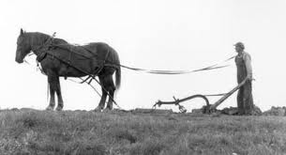
Anti-Slavery Northerners and Republicans
Most Northerners were against slavery, but they were not abolitionists. They didn’t want slavery to spread to the West or come back to the North. They wanted cheap or free land for whites only. They believed in a free-labor system– with no slavery and no slaves around. They also didn’t like slaveholders having so much wealth and political power. They voted Republican.
A northern farmer who wanted land for himself and his family.
Republican President Abraham Lincoln
10. How were anti-slavery people different from abolitionists?

Slide 11
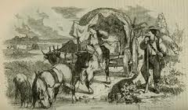
Northern Democrats
Some Northern farmers, especially those with family or other connections to the South, supported slavery.
Less than half of Northerners were Democrats, but they were a powerful political group. Some Democrats, like Illinois Senator Stephen A. Douglas, supported the idea of popular sovereignty in which the people who lived in a territory or state would decide whether slavery would be legal or not. Other Democrats were simply pro-slavery.
Illinois Senator Stephen A. Douglas
11. Many Northern Democrats supported popular sovereignty. What was it?

Slide 12
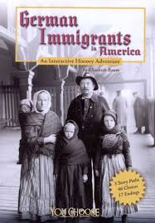
Southern Unionists
Some Southerners were strong supporters of slavery, but they were willing to try to find a compromise over the issue of slavery spreading to the West. People like Sam Houston did not think the Republican Party or President Lincoln were an immediate threat to slavery as many other Southerners believed. They did not want to risk a Civil War over the issue of slavery in the West.
Many immigrants and some Southerners shared the Unionist view.
Texas Senator and Governor Sam Houston
12. Why did Southern Unionists not support secession? That is, what did they not fear from the Republicans?

Slide 13
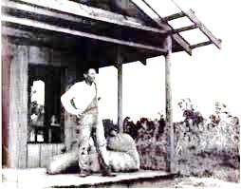
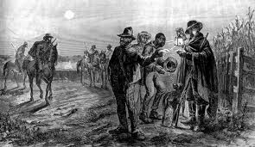
Southern Secessionists
Most Southern farmers did not own slaves, but many hoped to get slaves one day.
Most white Southerners believed the Republicans would (1) abolish slavery, (2) eliminate state’s rights, and (3) destroy the Southern way of life. Southerners like Jefferson Davis believed the South should secede (break away) and create their own country if Republicans took power in Washington, D.C.
Also, Southern White men were usually part of militia groups that patrolled the countryside looking for runaway slaves. They believed this was an important way to protect their families and their communities.
13. What is “secession”?
14. What did secessionists think the Republicans would do?
Democrat and Confederate President Jefferson Davis

Slide 14
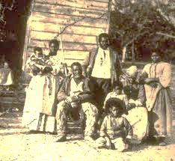
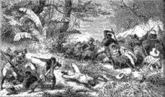
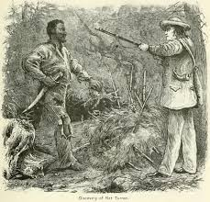
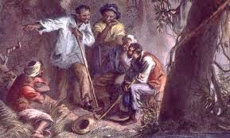
Southern Abolitionists
African Americans resisted their situation in various ways, but they were outnumbered and violently kept down by the white majority.
15. Who were the strongest opponents of slavery in the South?

Slide 15
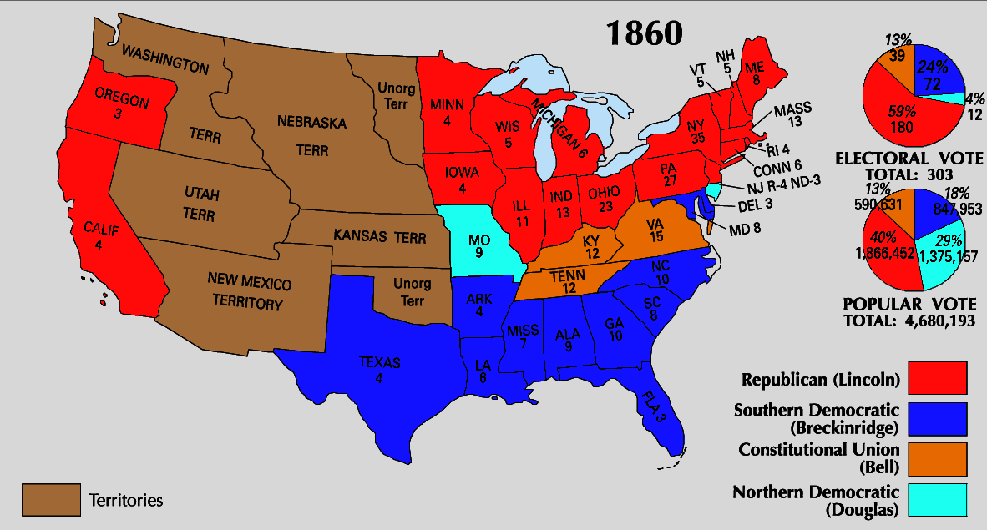
Results of the Election of 1860: 16. How will Southerners Respond?

