Slide 1
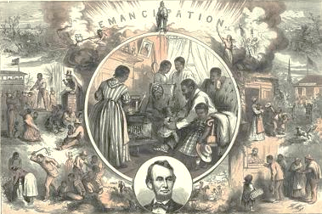

Slide 2
Details:
Blacks being whipped and forced to work; and sold off into slavery on the left side;
Blacks living in town, probably free on the right side;
An African American family at home in the middle;
President Lincoln at the bottom
The word Emancipation at the top
Conclusions:
Freedom with the 13th Amendment for blacks is a good thing and allows them to get out of the terrible condition of slavery, and President Lincoln and the Republicans take credit for this

Slide 3
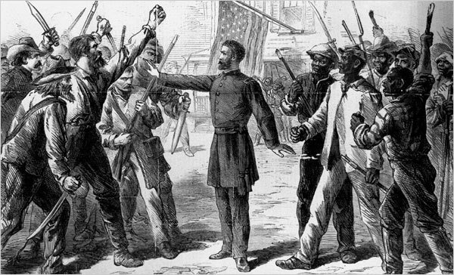
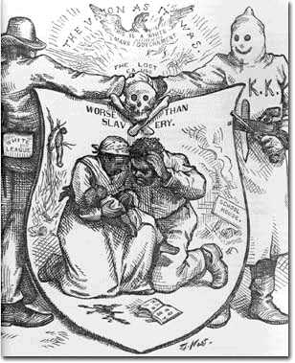

Slide 4
Details:
Conclusions:
Details:

Slide 5
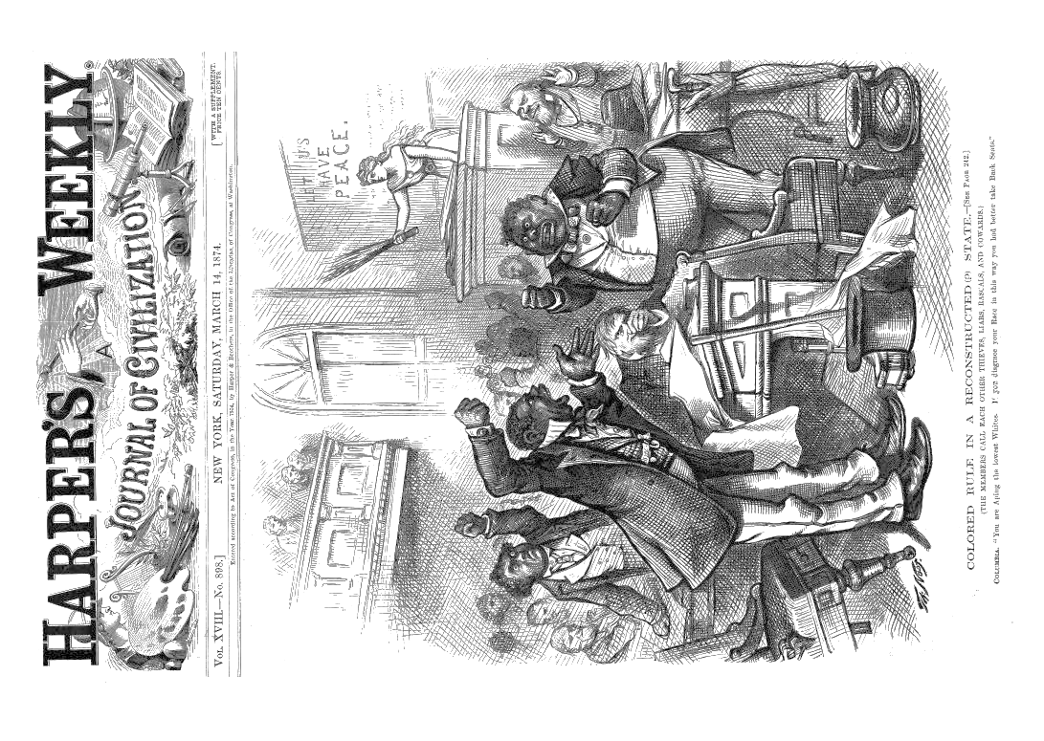

Slide 6
Details:
Conclusions:

Slide 7
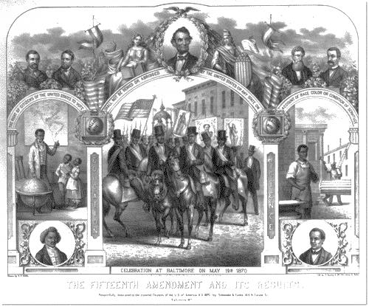

Slide 8
Details:
Conclusions:

Slide 9
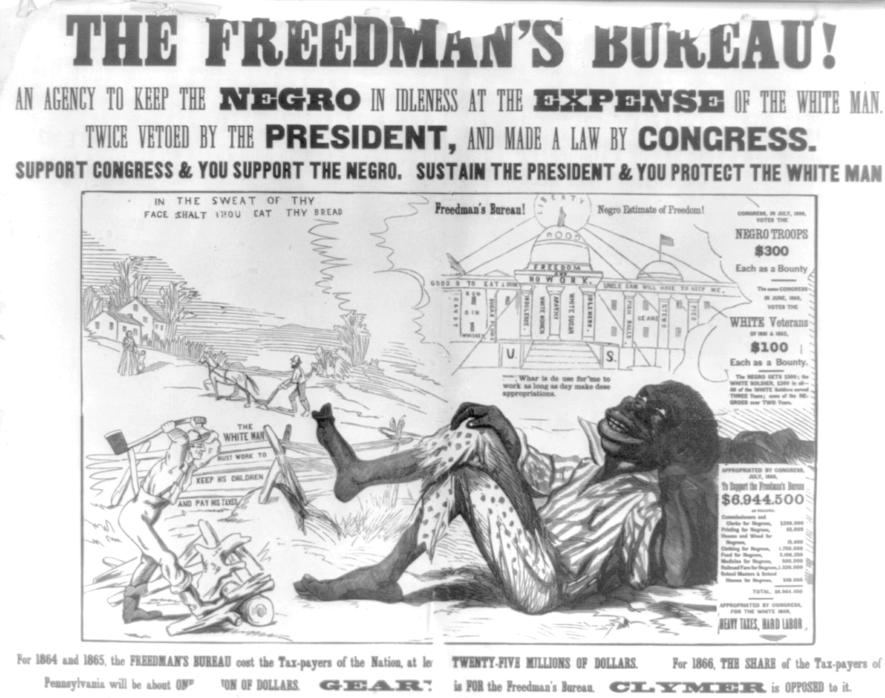

Slide 10
Details:
Conclusions:

Slide 11
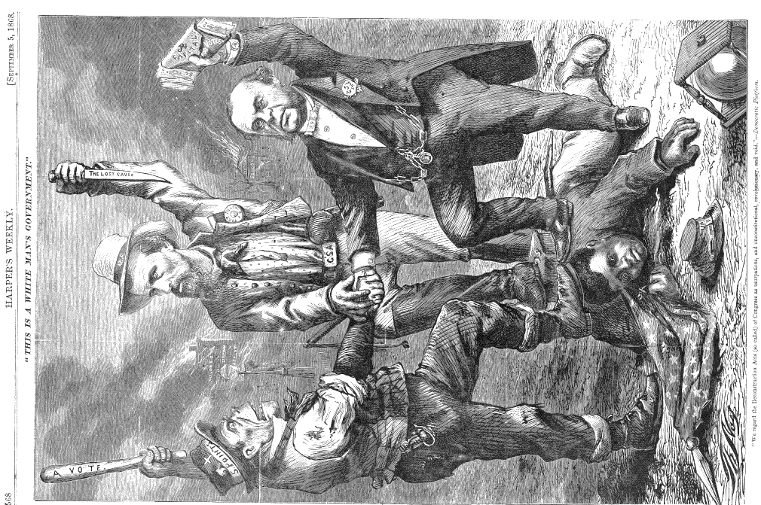

Slide 12
Details:
Conclusions:

