Slide 1
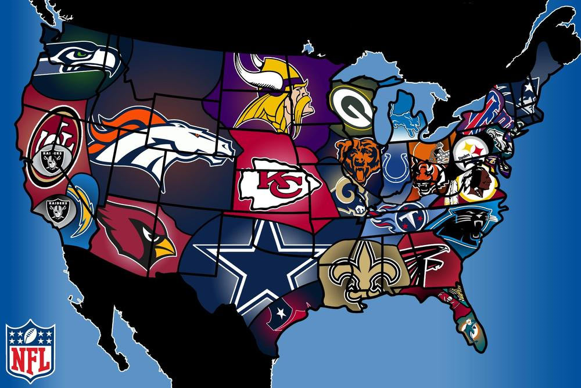
Thematic Maps Tutor
Thematic Maps Tutor
© Developed by Mr. Gillespie
Bailey Middle School, 2012
Next

Slide 2
Rain Fall Map
Next

Slide 3
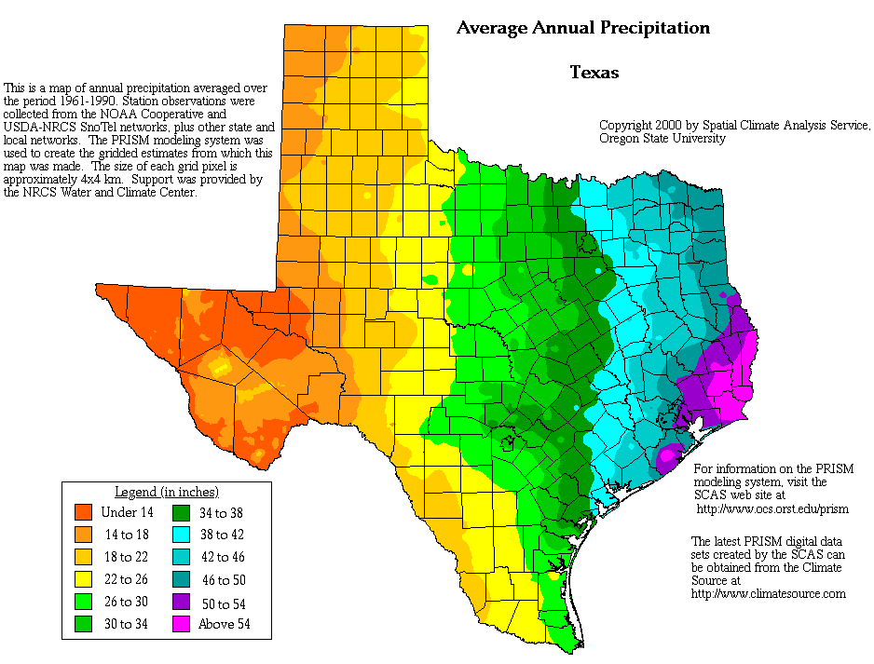
Question 1. What is the title of the map?
Next

Slide 4
Question 2: What measurement (feet? meters?)
is shown in the legend?
Next

Slide 5
Question 3. Which part of Texas is wetter—
the east or the west?
Next

Slide 6
Travis County
Question 4. What is the average rainfall in Travis
County each year?
Next

Slide 7
Election Map
Next

Slide 8
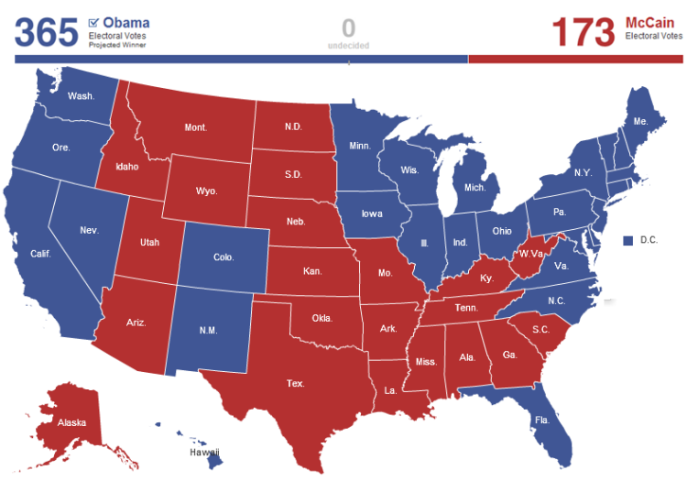
Question 5. Who were the candidates in this U.S. Presidential election?
Next

Slide 9
Question 6. Which candidate took Texas in the 2008 election?
Next

Slide 10
Question 7. Which candidate won all of the states in the Northeast?
Next

Slide 11
Temperature Map
Next

Slide 12
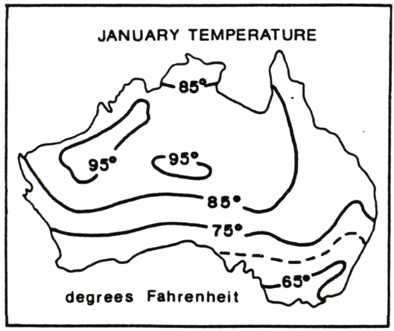
Map of Australia
N
Question 8. Which part of Australia has warmer temperatures in January: east or west?
Next

Slide 13
Map of Australia
N
Question 9. True or False: The temperature along most of the southeast coast is 65 degrees or below in January?
Next

Slide 14
Map of Australia
N
Question 10: True or False: The temperature below the line marked 75 degrees is usually 75 degrees or below in January
Next

Slide 15
U.S. History Maps
Next

Slide 16
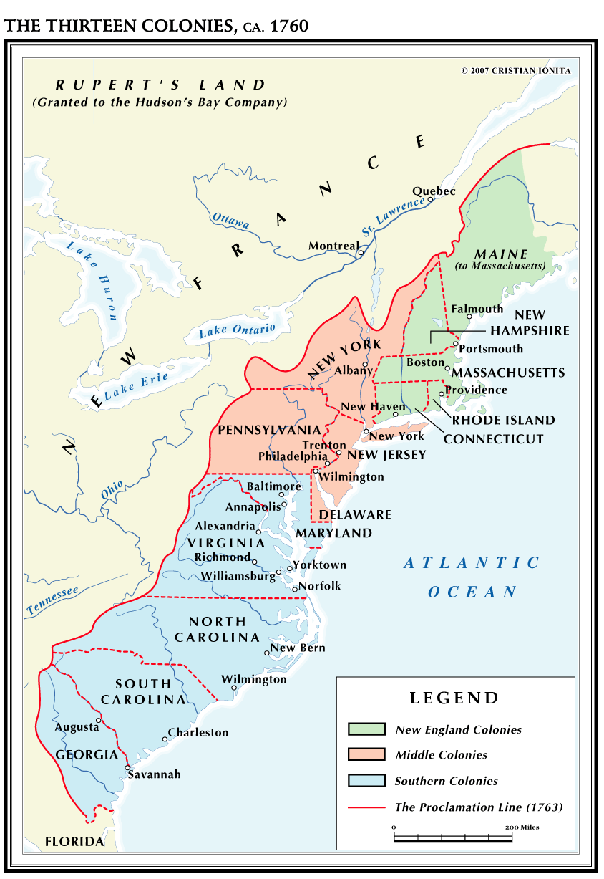
Question 11: True or False: Florida and Vermont were two of the British Thirteen Colonies in 1760?
Next

Slide 17
Question 12: True or False: New York and Pennsylvania were part of the Southern Colonies?
Next

Slide 18
Question 13: True or False: France controlled most of the territory west of the Thirteen Colonies?
Next

Slide 19
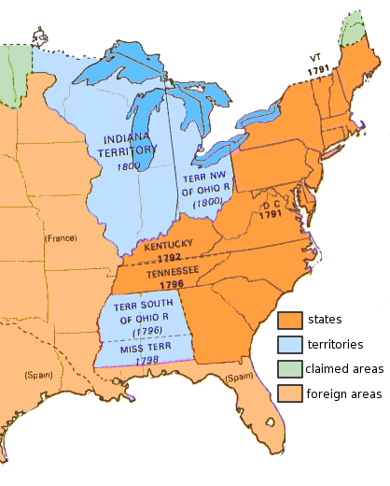
The United States in 1800
Question 14: True or False: Vermont (VT) became a state in 1791?
Next

Slide 20
The United States in 1800
Question 15: True or False: Ohio was a state by 1800.
Next

Slide 21
The United States in 1800
Question 16: Which foreign country controlled Florida in 1800?
Next

Slide 22
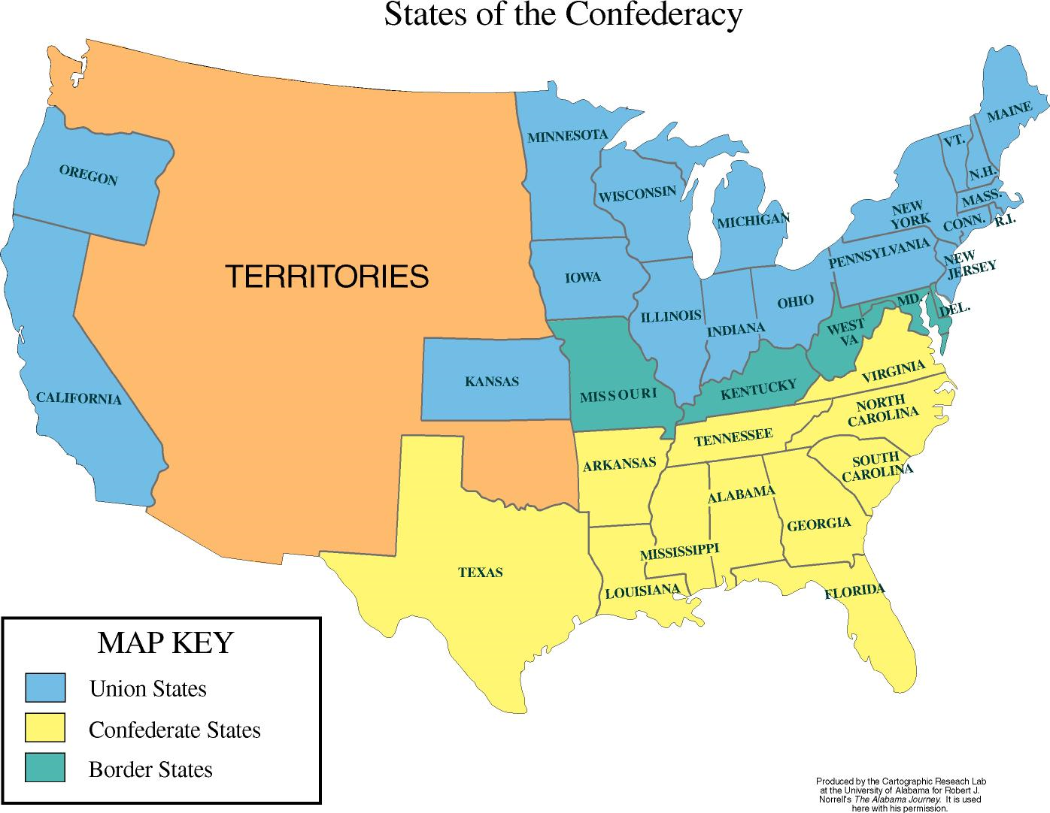
1861-1865
Question 17: This map shows how the United States was divided during the Civil War, 1861-1865. How many states withdrew from the United States to form the Confederacy?
Next

Slide 23
1861-1865
Question 18: True or False: The most northerly of the Confederate states was Alabama?
Next

Slide 24
1861-1865
Question 19: True or False: Texas stayed loyal to the Union?
Next

Slide 25
1861-1865
Question 20: The Border States allowed slavery but chose to remain with the Union and not join the Confederacy. Many of their citizens, however, did fight for the Confederacy. Name the five borders states, including the one that separated from one of the Confederate states during the war.
Next

Slide 26
Language Map
Next

Slide 27
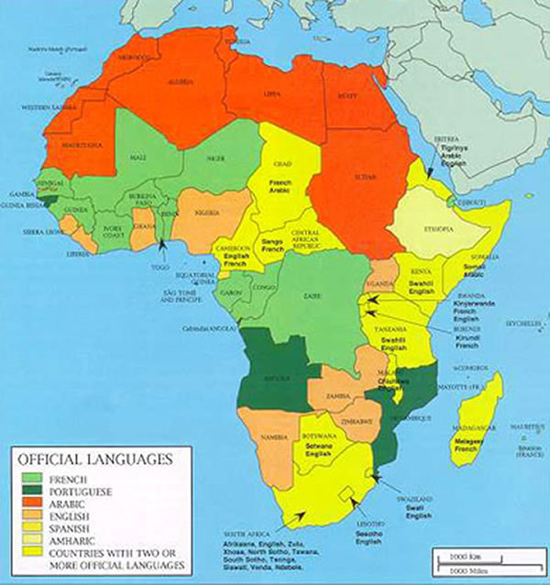
Question 21: In the late 1800s, European countries divided up Africa among them. In the 1960s, many of those countries became independent , but kept the language of their former rulers as their official language. What is the official language of Angola and Mozambique today?
Nigeria
Ethiopia
Angola
Mozambique
South Africa
Next

Slide 28
Question 22: Which language is dominant in northern Africa?
Next

Slide 29
Plate Tectonics
Map
Next

Slide 30
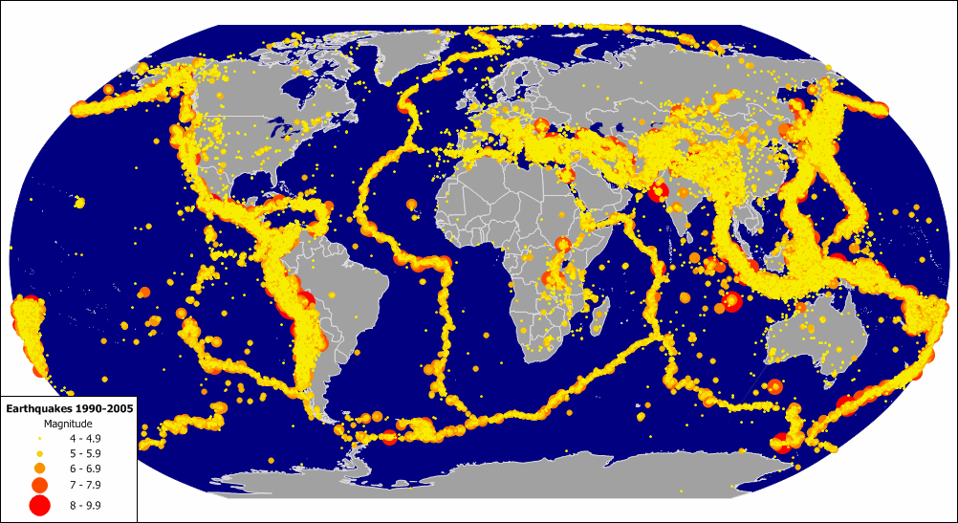
Question 23: True or False: Brazil has more earthquakes than Indonesia?
Next

Slide 31
Question 24: True or False: The eastern part of the United States has more earthquakes than the western?
Next

Slide 32
Earthquake Map
Next

Slide 33
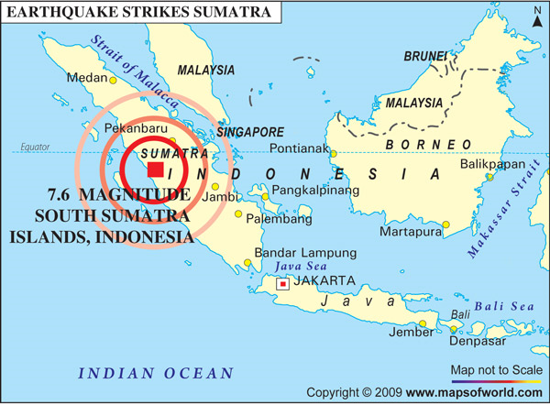
Question 25: Indonesia is an archipelago (a group of islands). True or False: Borneo and Sumatra are two of the main islands of Indonesia?
Next

Slide 34
Question 26: True or False--According to the map, an earthquake of 7.6 magnitude struck Borneo?
Next

Slide 35
Maps of Canada
Next

Slide 36
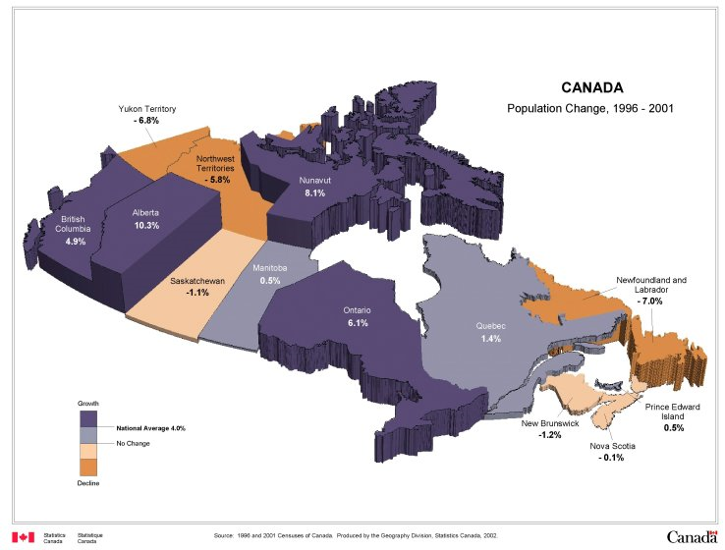
Question 27: This map shows Canada’s ten provinces and three territories. Which province or territory had the greatest population increase between 1996 and 2001?
Next

Slide 37
Question 28: Quebec is Canada’s only province in which most of the people speak French as their first language. What was the percent population increase in Quebec between 1996 and 2001?
Next

Slide 38
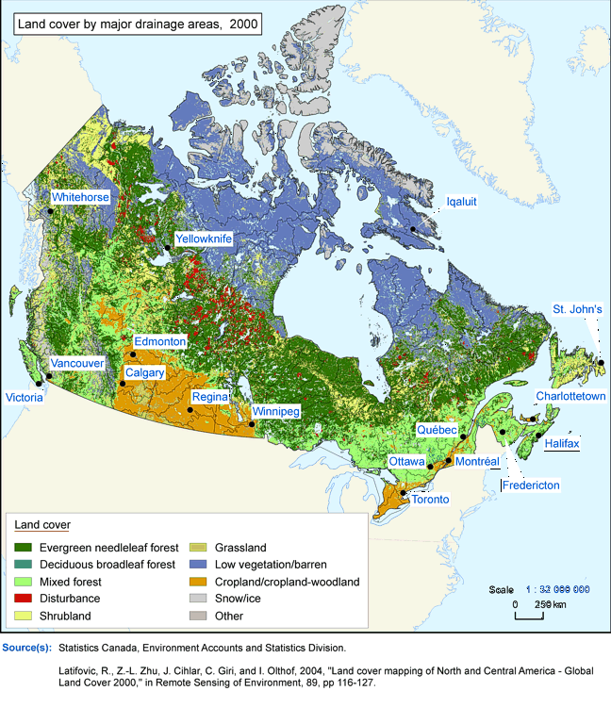
Question 29: Which two of the following cities are in Canada’s cropland—Halifax, Vancouver, Regina, Edmonton?
Next

Slide 39
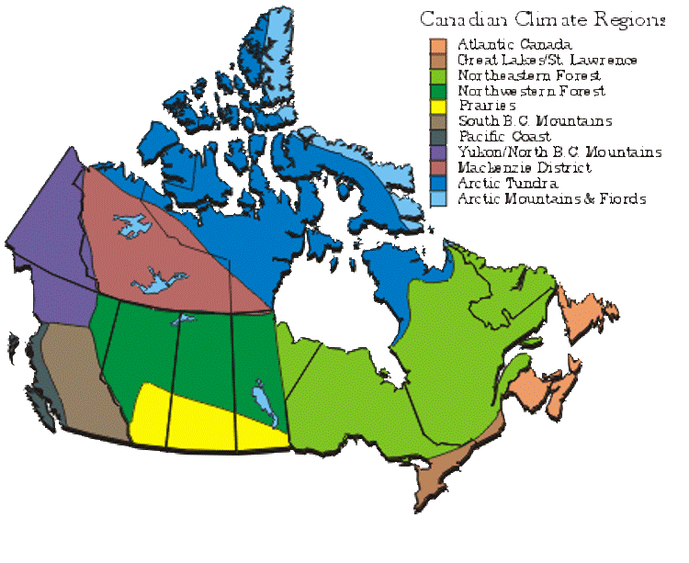
Link to Map #28
Question 30: Which of Canada’s provinces or territories is mostly covered by tundra (vast treeless, frozen plain)? (Hint: look at map #28 to find the names of Canada’s provinces and territories.)
Next

Slide 40
Battle Maps
Next

Slide 41
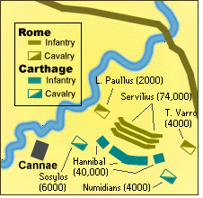
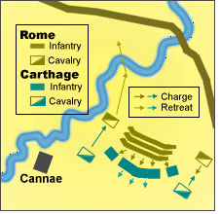
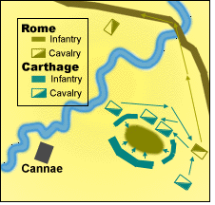
Rome versus Carthage: The Battle of Cannae, 216 B.C.
Phase 1
Phase 2
Phase 3
Rome was the greatest empire in the ancient world. Its major enemy was empire of Carthage, whose chief city was in North Africa. The greatest battle between the two enemies was fought at Cannae in Italy in 216 B.C. See if you can follow the battle maps.
Question 31: True or False—At the beginning of the battle (phase 1), Rome had 50,000 troops and Carthage 80,000.
Next

Slide 42
Rome versus Carthage: The Battle of Cannae, 216 B.C.
Phase 1
Phase 2
Phase 3
Question 32: True or False—During phase 2 of the battle, the Carthaginian cavalry attacked the Roman cavalry while the Carthaginian infantry retreated ( moved back).
Next

Slide 43
Rome versus Carthage: The Battle of Cannae, 216 B.C.
Phase 1
Phase 2
Phase 3
Question 33: True or False—By the end of the battle (phase 3), the Roman infantry and cavalry had surrounded the Carthaginian forces.
Next

Slide 44
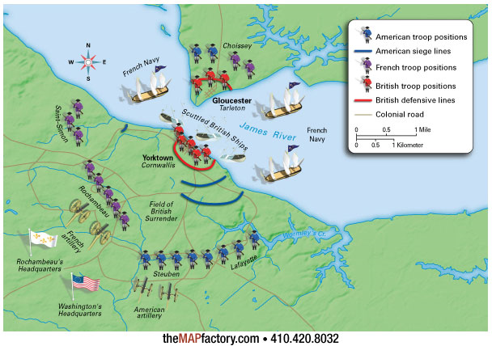
Battle of Yorktown, 1781, American Revolution
Question 34: True or False—The map shows that French forces were surrounded by the combined American and British armies.
Next

Slide 45
Battle of Yorktown, 1781, American Revolution
Question 35: True or False—It can be concluded from analyzing this map, that the aid of the French army and help of the French fleet proved decisive in Washington’s victory over British General Cornwallis at this battle.
Next

Slide 46
Graduated Circle
Maps
Next

Slide 47
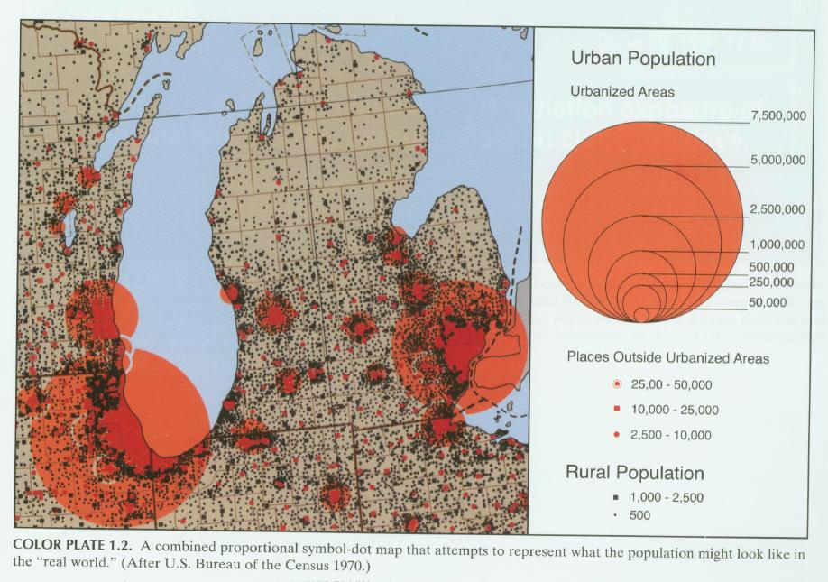
MIlwaukee
Detroit
Chicago
Question 36: Which city has about 7,500,000 in its urban area?
Next

Slide 48
MIlwaukee
Detroit
Chicago
Question 37. About how many people does Detroit have in its urban area?
Next

Slide 49
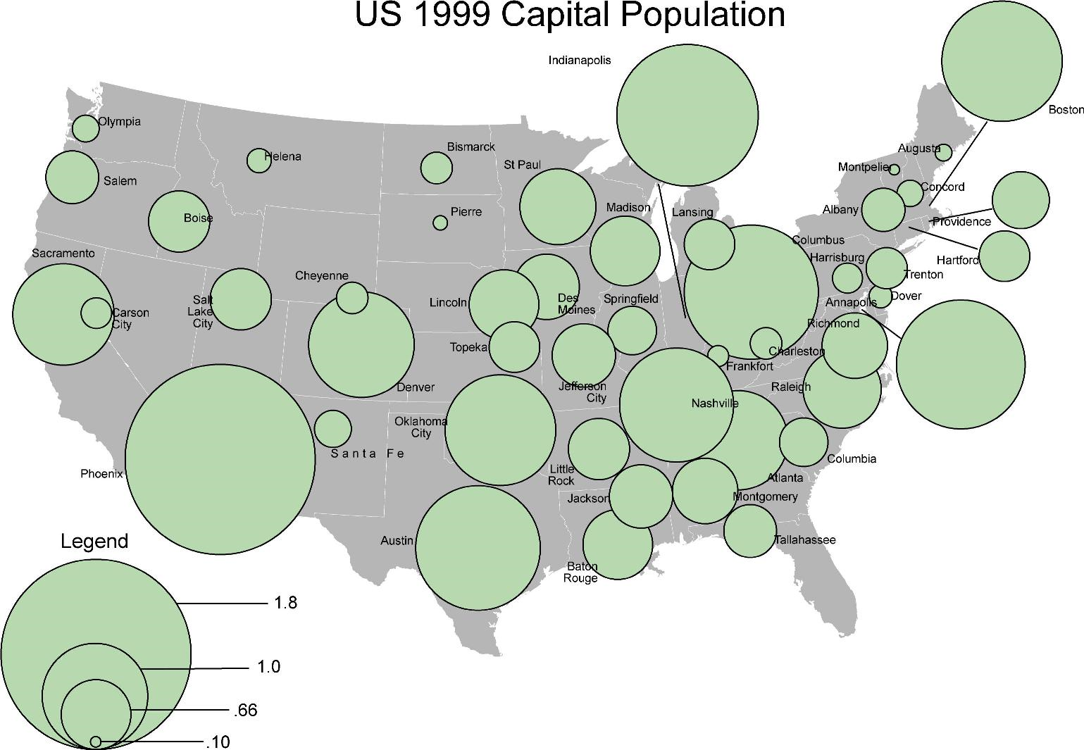
million
million
Question 38: Which state capital has the largest population?
Next

Slide 50
million
million
Question 39: True or False--Based on the map, it can be said that Austin is one of the smallest state capitals in population.
Next

Slide 51
City Neighborhood
Map
Next

Slide 52
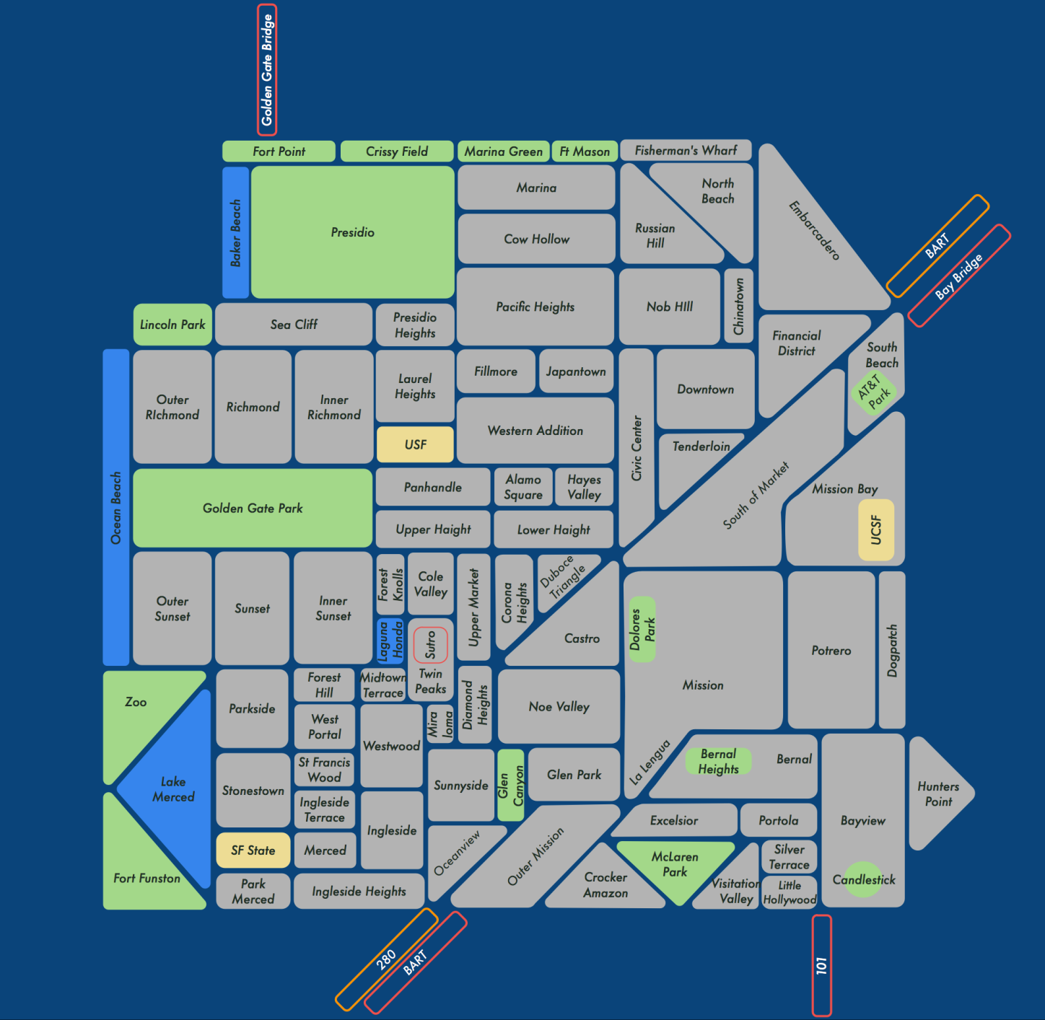
San Francisco City Neighborhoods
Question 40: Which San Francisco neighborhood is bordered by Chinatown, Pacific Heights, and Russian Hill?
Next

Slide 53
City Street
Map
Next

Slide 54
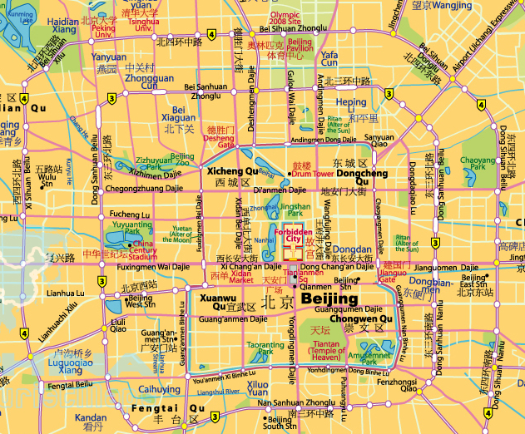
Central Beijing
N
Question 41: In which part of the city (northeast, northwest, southeast, southwest) will you find Beijing’s universities?
Next

Slide 55
Central Beijing
N
Question 42: The Emperors of China lived in the Forbidden City. Which square is just south of the Forbidden City?
Next

Slide 56
Central Beijing
N
Question 43: What temple might you visit near the Amusement Park?
Next

Slide 57
Natural Resources
Map
Next

Slide 58
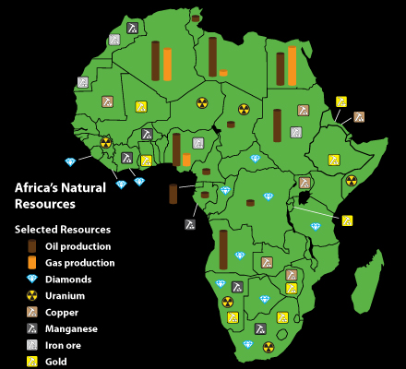
Question 44: What is the title of the map?
Next

Slide 59
Question 45: Based on the map, does Somalia have diamonds among its natural resources?
Next

Slide 60
Question 46. Which among the following countries has the greatest oil production—Chad, Ethiopia, Angola, Cameroon?
Next

Slide 61
Cartogram
Next

Slide 62
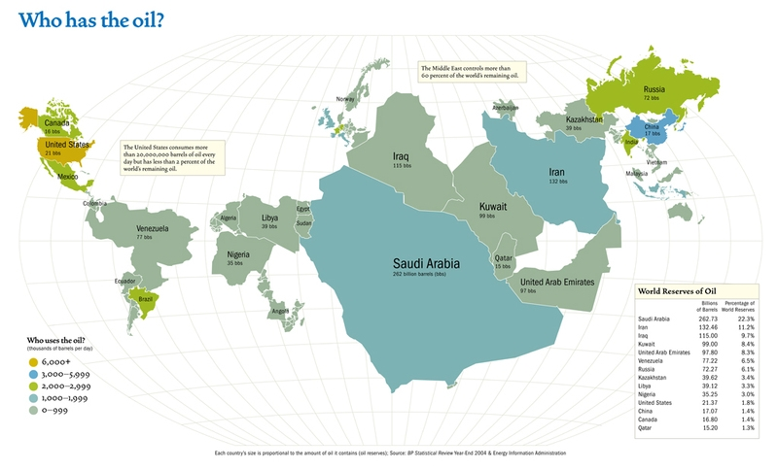
Note: the size of the country indicates the amount of oil it has underground.
Question 47: According to the map, which country has the greatest oil reserves?
Next

Slide 63
Note: the size of the country indicates the amount of oil it has underground.
Question 48: True or False--A look at the map shows that the United States is among the five countries with the greatest oil reserves.
Next

Slide 64
Note: the size of the country indicates the amount of oil it has underground.
Question 49: True or False--According to the map, Brazil has the greatest oil reserves of any country in the Americas.
Next

Slide 65
Fun Map
Next

Slide 66
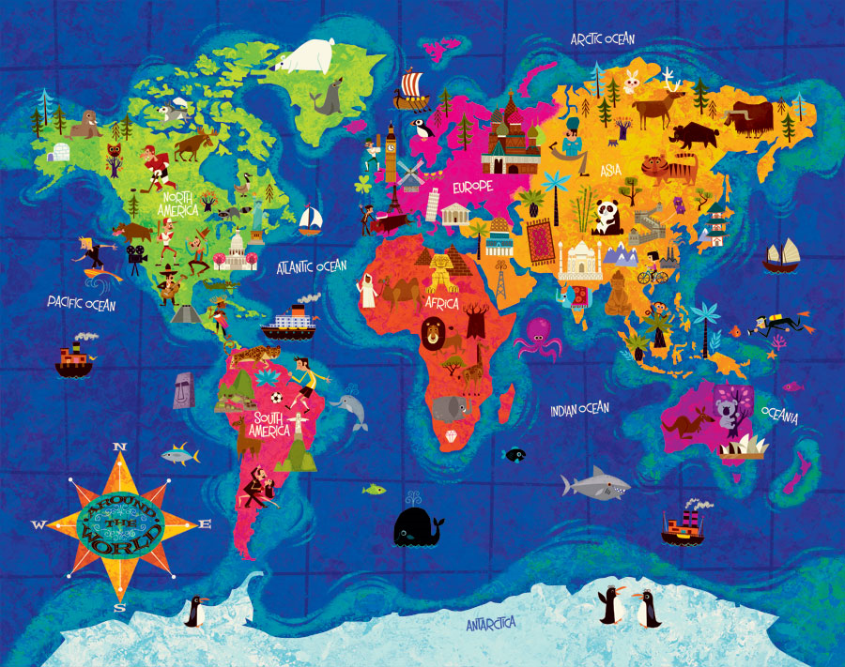
Question 50: What is the Koala
doing on this map?
Next

Slide 67
The End

